Slide 1
Lectuer-9 Database Systems and Applications
Ashish Narang

Slide 2
First Semester
2020-21

Slide 3
Contents
What are Indexes?
Sparse and Dense Indexes
Primary Index
Clustering Index
Secondary Index
Multilevel Indexes
B⁺ Tree Indexing

Slide 4
Introduction
Indexes are auxiliary access structures which are used to speed up the retrieval of records.
The index structures are additional files on disk which provide alternative ways to access the records without affecting the physical placement of records in the primary data file on disk.

Slide 5
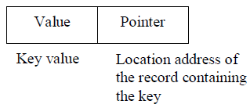
Contd..
For a file with a given record structure consisting of several fields (or attributes), an index access structure is usually defined on a single field of a file, called an indexing field (or indexing attribute).
Like data file records, index records are also stored in database. Any index record normally has two fields.

Slide 6
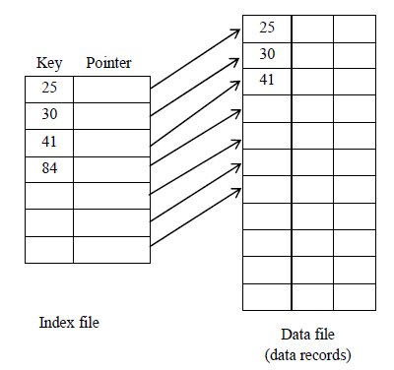
Contd..

Slide 7
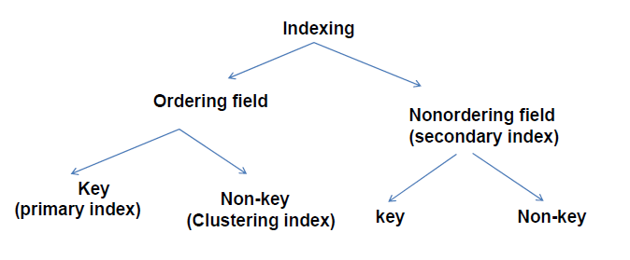
Contd..

Slide 8
Sparse and Dense Indexes
Indexes can also be characterized as dense or sparse.
A dense index has an index entry for every search key value (every record) in the data file.
A sparse (or non dense) index, on the other hand, has index entries for only some of the search values.

Slide 9
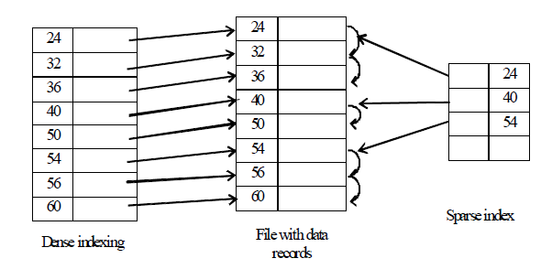
Contd..

Slide 10
Types of Single-Level Indexes
Primary Index
–Defined on an ordered data file.
–The data file is ordered on a key field.
–Includes one index entry for each block in the data file; the index entry has the key field value for the first record in the block, which is called the block anchor.
–A primary index is a nondense (sparse) index, since it includes an entry for each disk block of the data file and the keys of its anchor record rather than for every search value.

Slide 11
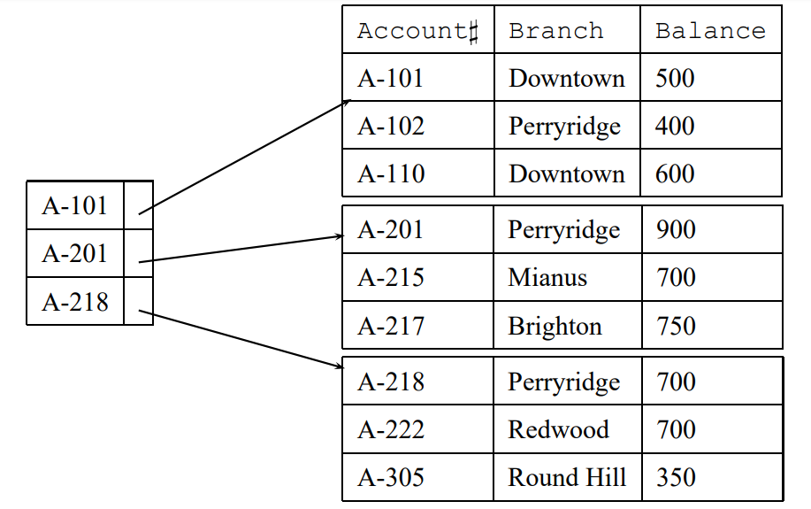
Primary index on the ordering key field

Slide 12
Example 1
Suppose that we have an ordered file with r = 30,000 records stored on a disk with block size B = 1024 bytes. File records are of fixed size and are unspanned, with record length R = 100 bytes.
The blocking factor for the file would be bfr = ⎣(B/R)⎦ = ⎣(1024/100)⎦ = 10 records per block.
The number of blocks needed for the file is b = ⎡(r/bfr)⎤ = ⎡(30000/10)⎤ = 3000 blocks.
A binary search on the data file would need approximately ⎡log₂b⎤= ⎡(log₂3000)⎤ = 12 block accesses.

Slide 13
Contd..
Now suppose that the ordering key field of the file is V = 9 bytes long, a block pointer is P = 6 bytes long, and we have constructed a primary index for the file.
The size of each index entry is R_{i} = (9 + 6) = 15 bytes, so the blocking factor for the index is bfr_{i} = ⎣(B/Ri)⎦ = ⎣(1024/15)⎦ = 68 entries per block.
The number of index blocks is hence b_{i} = ⎡(r_{i}/bfr_{i})⎤ = ⎡(3000/68)⎤ = 45 blocks.
To perform a binary search on the index file would need ⎡(log₂b_{i})⎤ = ⎡(log₂45)⎤ = 6 block accesses.
To search for a record using the index, we need one additional block access to the data file for a total of 6 + 1 = 7 block accesses—an improvement over binary search on the data file, which required 12 disk block accesses.

Slide 14
Clustering Index
Defined on an ordered data file.
The data file is ordered on a non-key field unlike primary index.
Includes one index entry for each distinct value of the field.
The index entry points to the first data block that contains records with that field value.

Slide 15
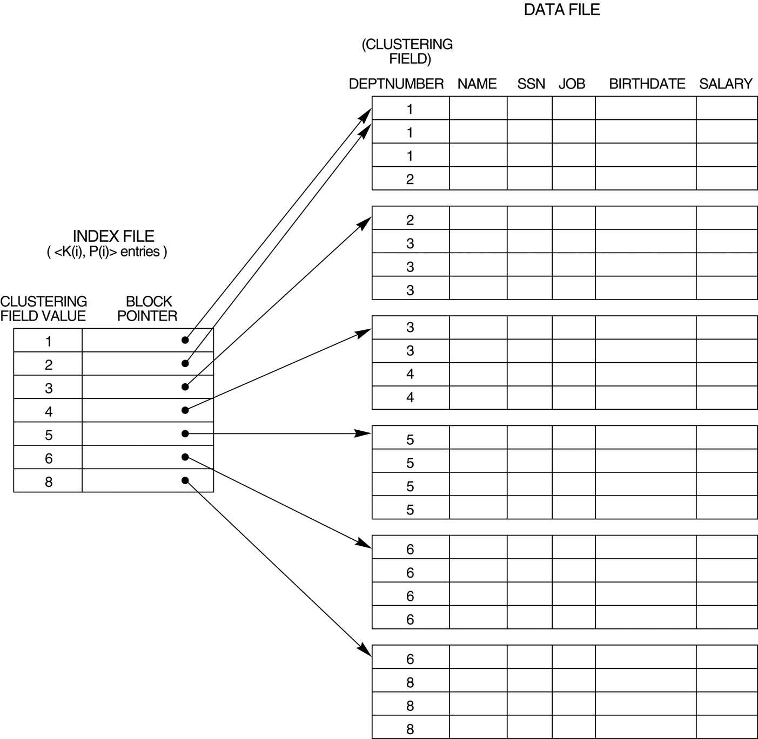
Contd..

Slide 16
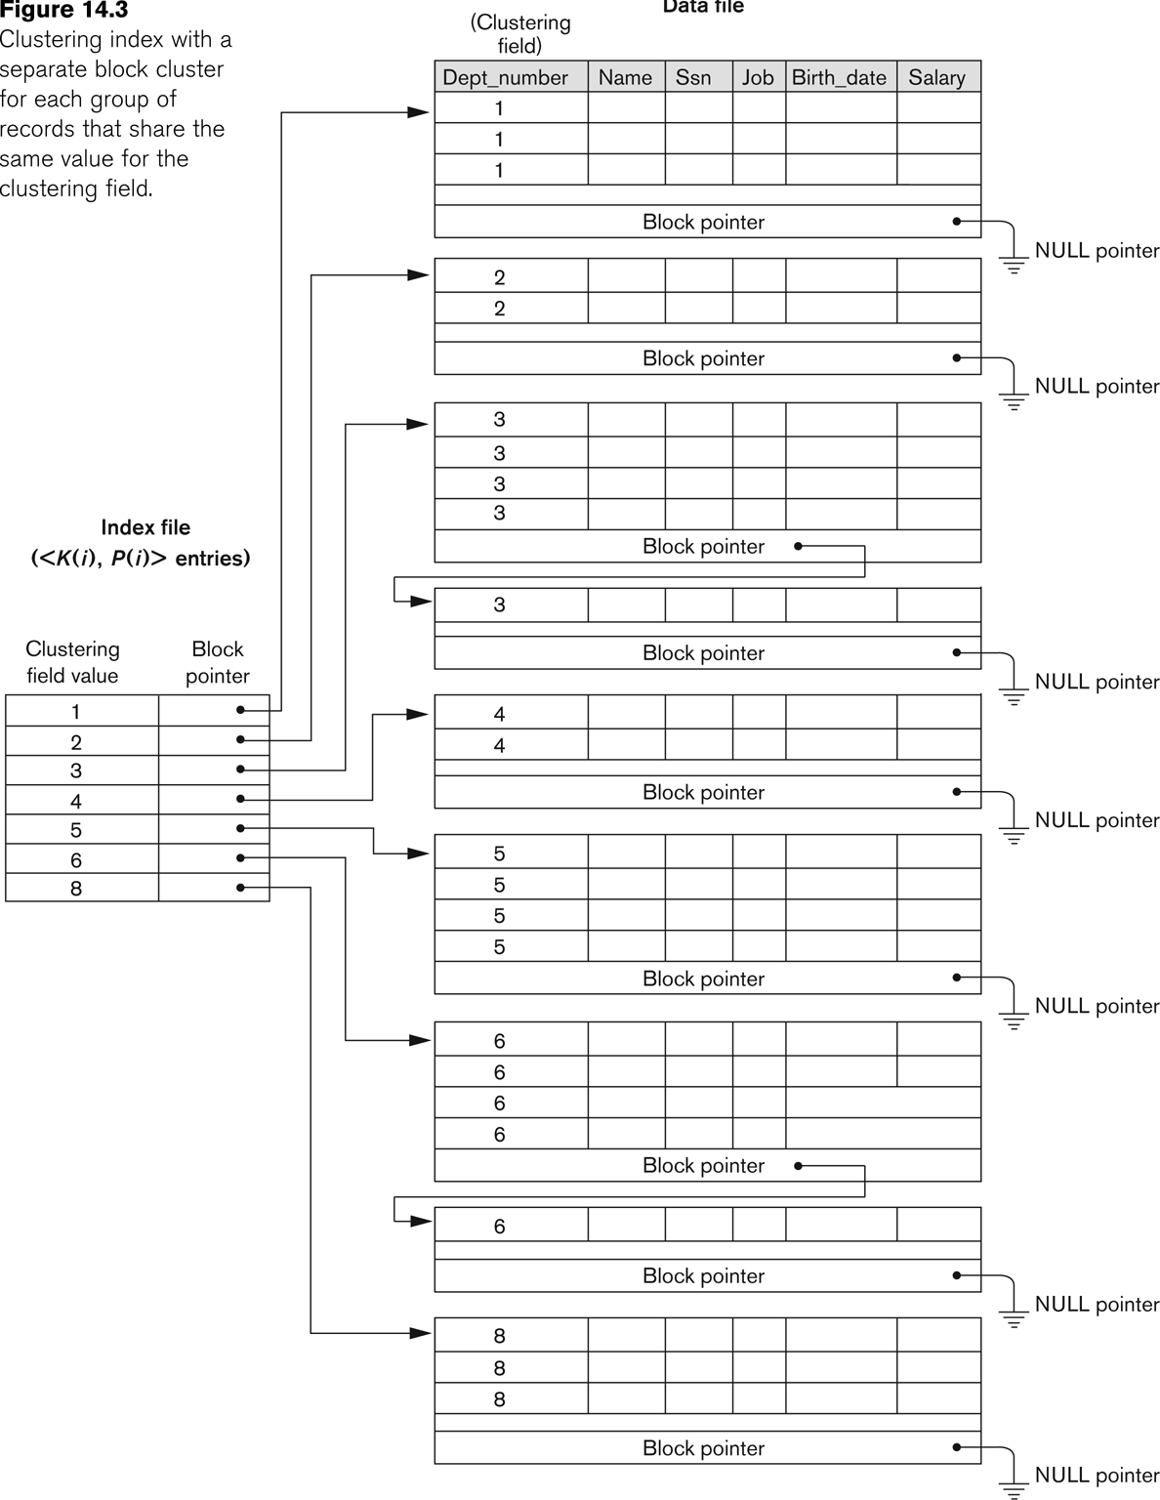
Contd..

Slide 17
Secondary Index
The secondary index may be on a field which is a candidate key and has a unique value in every record, or a non-key with duplicate values.
The index is an ordered file with two fields.
The first field is of the same data type as some non-ordering field of the data file, i.e., an indexing field.
The second field is either a block pointer or a record pointer.
There can be many secondary indexes (and hence, indexing fields) for the same file.
Includes one entry for each record in the data file; hence, it is a dense index

Slide 18
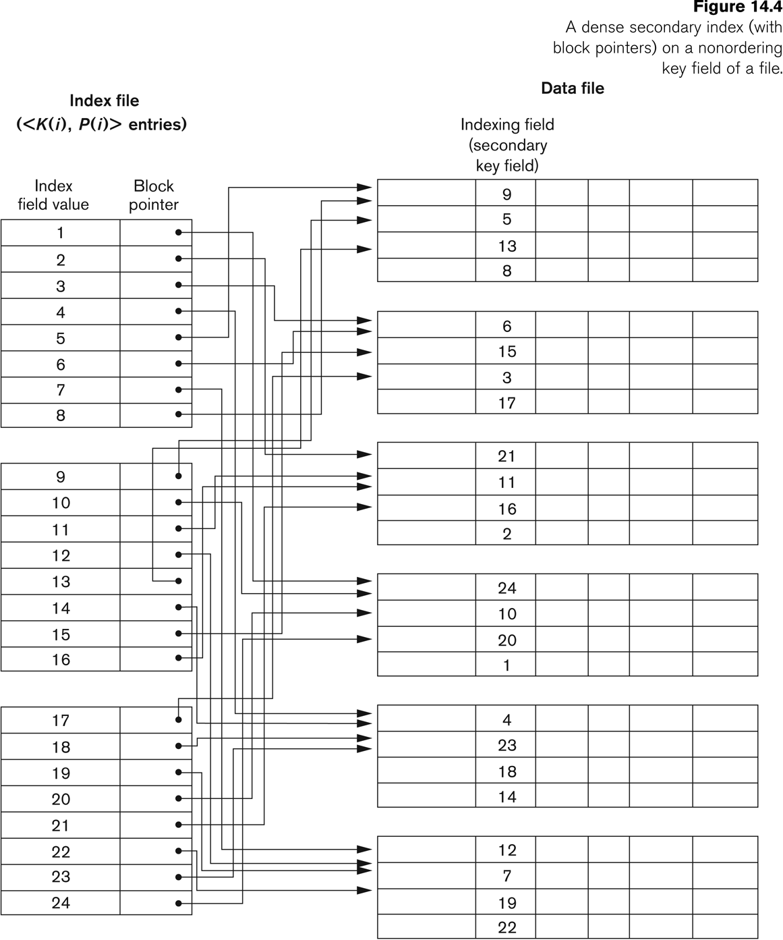
Contd..

Slide 19
Example 2
Suppose that we have an unordered file with r = 30,000 records stored on a disk with block size B = 1024 bytes. File records are of fixed size and are unspanned, with record length R = 100 bytes.
The blocking factor for the file would be bfr = ⎣(B/R)⎦ = ⎣(1024/100)⎦ = 10 records per block.
The number of blocks needed for the file is b = ⎡(r/bfr)⎤ = ⎡(30000/10)⎤ = 3000 blocks.
A linear search on the data file would need approximately 3000/2=1500 blocks.

Slide 20
Contd..
Now suppose that the ordering key field of the file is V = 9 bytes long, a block pointer is P = 6 bytes long, and we have constructed a primary index for the file.
The size of each index entry is R_{i} = (9 + 6) = 15 bytes, so the blocking factor for the index is bfr_{i} = ⎣(B/Ri)⎦ = ⎣(1024/15)⎦ = 68 entries per block.
The number of index blocks is hence b_{i} = ⎡(r_{i}/bfr_{i})⎤ = ⎡(30000/68)⎤ = 442 blocks.
To perform a binary search on the index file would need ⎡(log₂b_{i})⎤ = ⎡(log₂442)⎤ = 9 block accesses.
To search for a record using the index, we need one additional block access to the data file for a total of 9 + 1 = 10 block accesses—a vast improvement over linear search on the data file, which required 1500 disk block accesses.

Slide 21
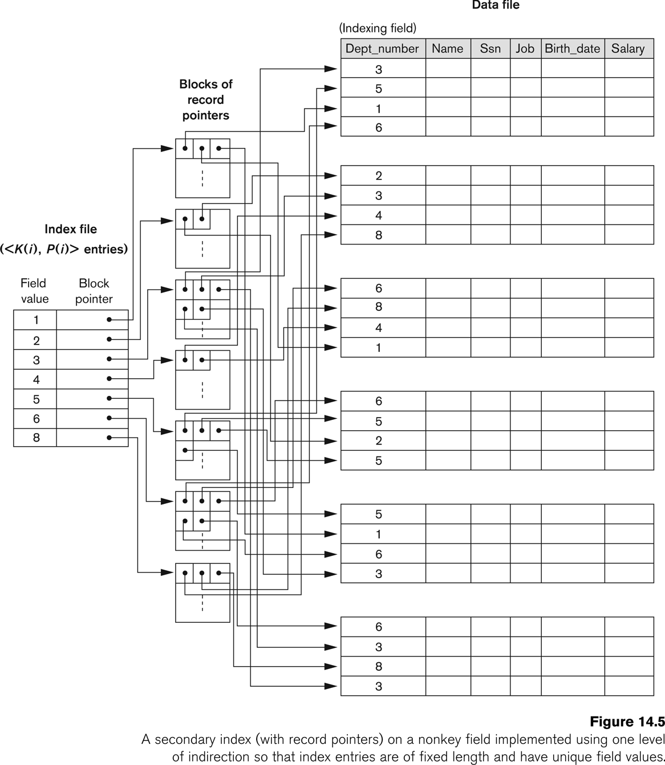
Contd..

Slide 22
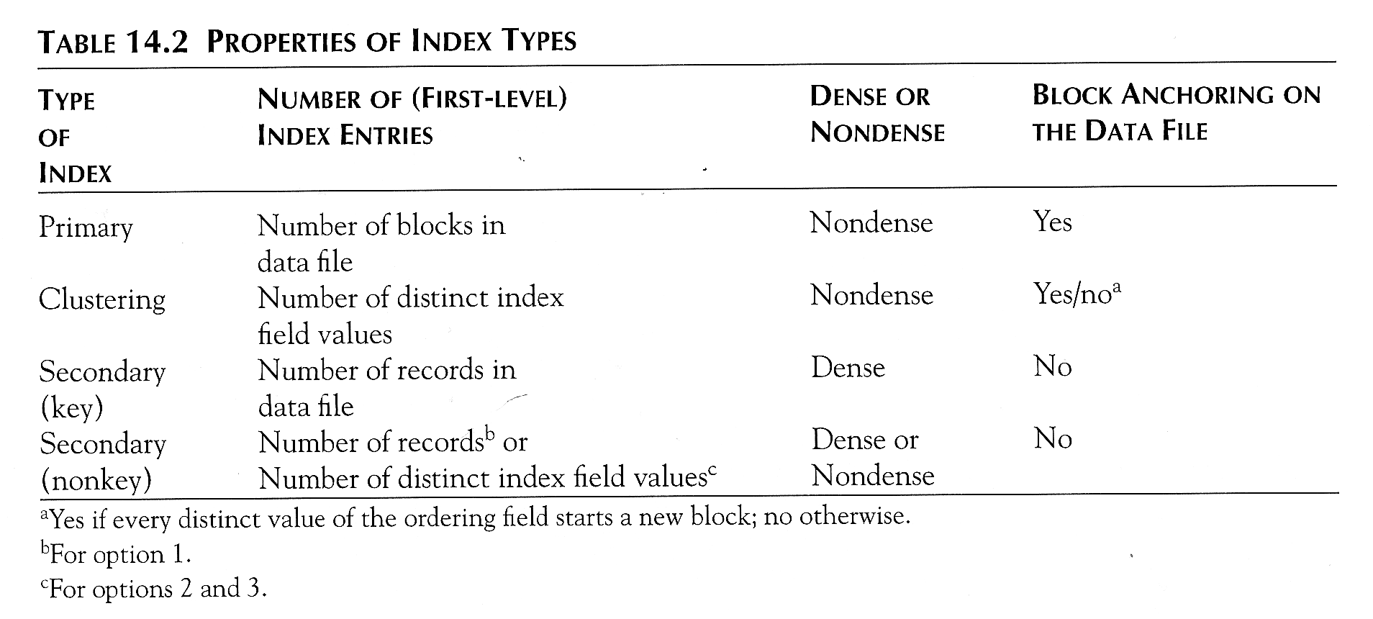
Properties of Index Types

Slide 23
Multi-Level Indexes
Because a single-level index is an ordered file, we can create a primary index to the index itself.
In this case, the original index file is called the first-level index and the index to the index is called the second-level index.
We can repeat the process, creating a third, fourth, ..., top level until all entries of the top level fit in one disk block.
A multi-level index can be created for any type of first-level index (primary, secondary, clustering) as long as the first-level index consists of more than one disk block.

Slide 24
Contd..
Such a multi-level index is a form of search tree
However, insertion and deletion of new index entries is a severe problem because every level of the index is an ordered file.

Slide 25
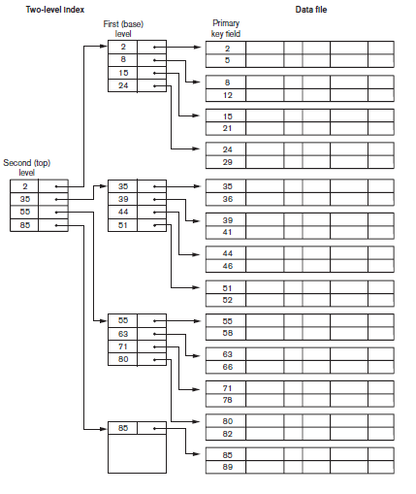
Contd..

Slide 26
Example 3
Suppose that the dense secondary index of Example 2 is converted into a multilevel index. We calculated the index blocking factor bfr_{i} = 68 index entries per block, the number of first level blocks b1 = 442 blocks was also calculated.
The number of second-level blocks will be b2 = ⎡(b1/ bfr_{i} )⎤ = ⎡(442/68)⎤ = 7 blocks, and the number of third-level blocks will be b3 = ⎡(b2/ bfr_{i} )⎤ = ⎡(7/68)⎤ = 1 block.
Hence, the third level is the top level of the index, and t = 3.
To access a record by searching the multilevel index, we must access one block at each level plus one block from the data file, so we need t + 1 = 3 + 1 = 4 block accesses.

Slide 27
Search Trees
A search tree is a special type of tree that is used to guide the search for a record, given the value of one of the record’s field.
A search tree of order p is a tree such that each node contains at most p − 1 search values and p pointers in the order <P₁, K₁, P₂, K₂, ..., P_{q−1}, K_{q−1}, P_{q}>, where q ≤ p. Each P_{i} is a pointer to a child node (or a NULL pointer), and each K_{i} is a search value from some ordered set of values. All search values are assumed to be unique

Slide 28
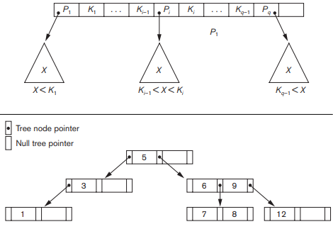


Contd..

Slide 29
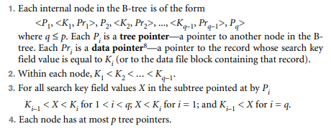
B-Trees
A B-tree of order p, when used as an access structure on a key field to search for records in a data file, can be defined as follows:

Slide 30
Contd..
5. Each node, except the root and leaf nodes, has at least ⎡(p/2)⎤ tree pointers. The root node has at least two tree pointers unless it is the only node in the tree.
6. A node with q tree pointers, q ≤ p, has q – 1 search key field values (and hence has q – 1 data pointers).
7. All leaf nodes are at the same level. Leaf nodes have the same structure as internal nodes except that all of their tree pointers P_{i} are NULL.

Slide 31
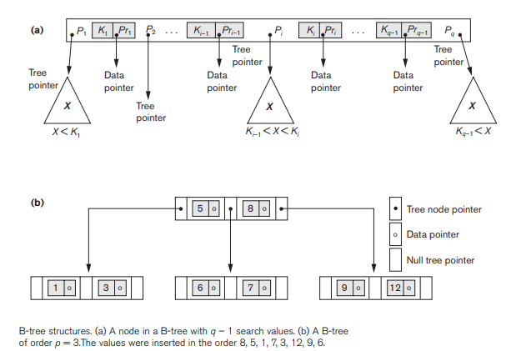
Contd..

Slide 32
B⁺ Trees
In a B-tree, every value of the search field appears once at some level in the tree, along with a data pointer. In a B+-tree, data pointers are stored only at the leaf nodes of the tree.
The structure of leaf nodes differs from the structure of internal nodes.
The leaf nodes have an entry for every value of the search field, along with a data pointer to the record

Slide 33
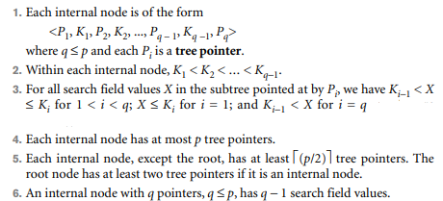
Internal Node

Slide 34

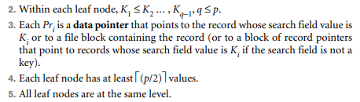
Leaf Node

Slide 35
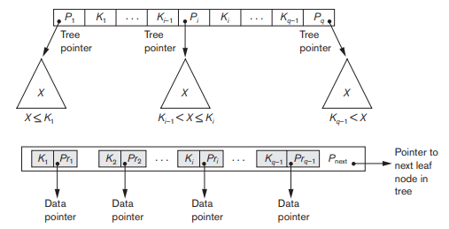
Contd..

Slide 36
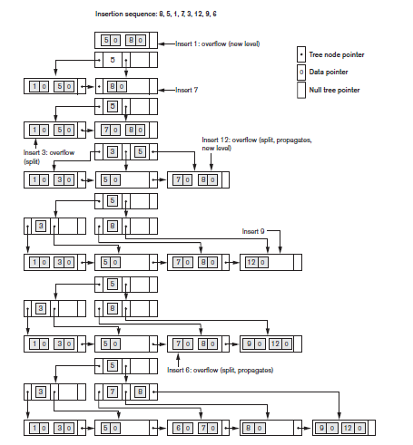

Slide 37
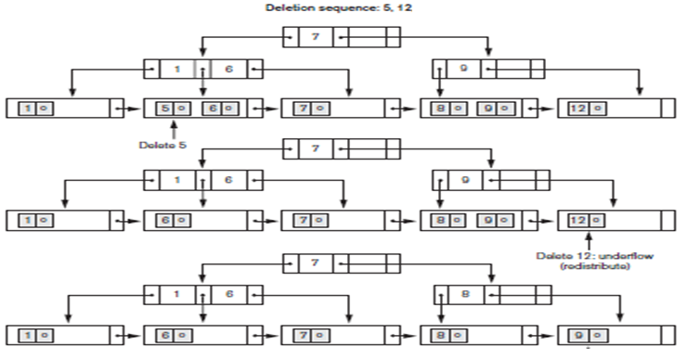
Contd..

